Slide 1
“(Non)Action Has Consequences:
Reasons and Ways for Young People to Participate in the Decision-Making Process at Home and EU”
Velingrad, Bulgaria
March 2012
THE RELATIONSHIP BETWEEN YOUTH UNEMPLOYMENT AND DEMOGRAPHIC DEVELOPMENTS
KALOYAN STAYKOV (IME)
This project has been funded with support from the Youth in Action Program of the European Commission, managed in Bulgaria by the National Centre “European Youth Programmes and Initiatives”. This publication reflects the views only of the author, and the Commission, the Youth in Action Program and the National Centre “European Youth Programmes and Initiatives” cannot be held responsible for any use which may be made of the information contained therein.

Slide 2
Structure
Population projections
Micro-effects
Macro-effects
What does it all mean? … for youth unemployment.

Slide 3
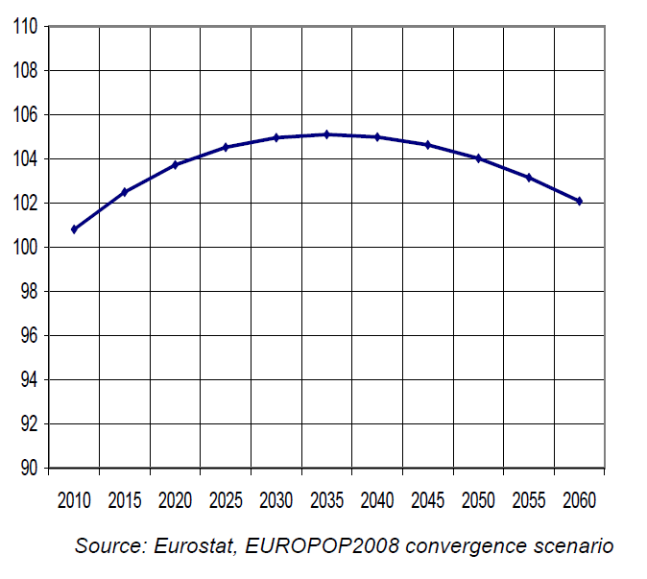
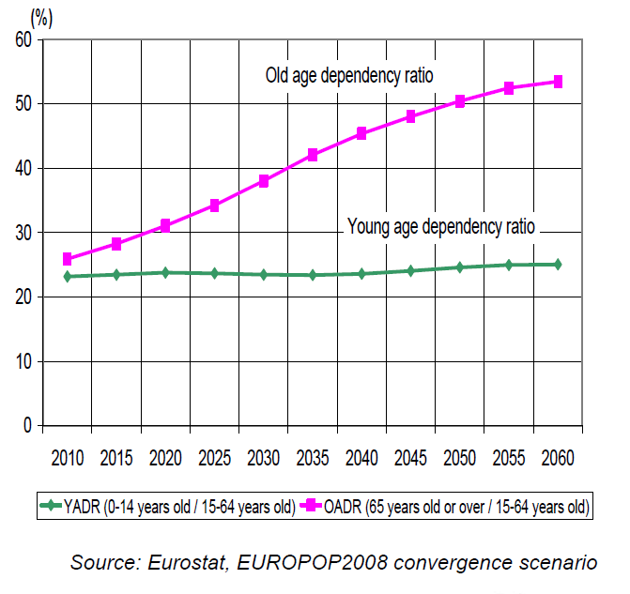
Population Projections

Slide 4
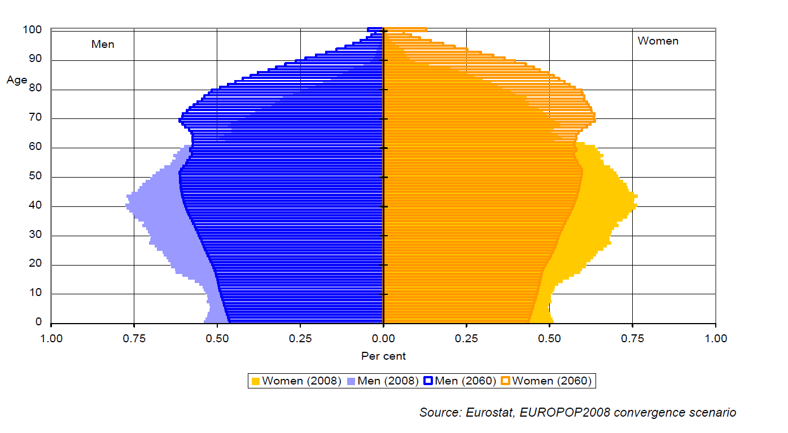
Population Pyramid

Slide 5
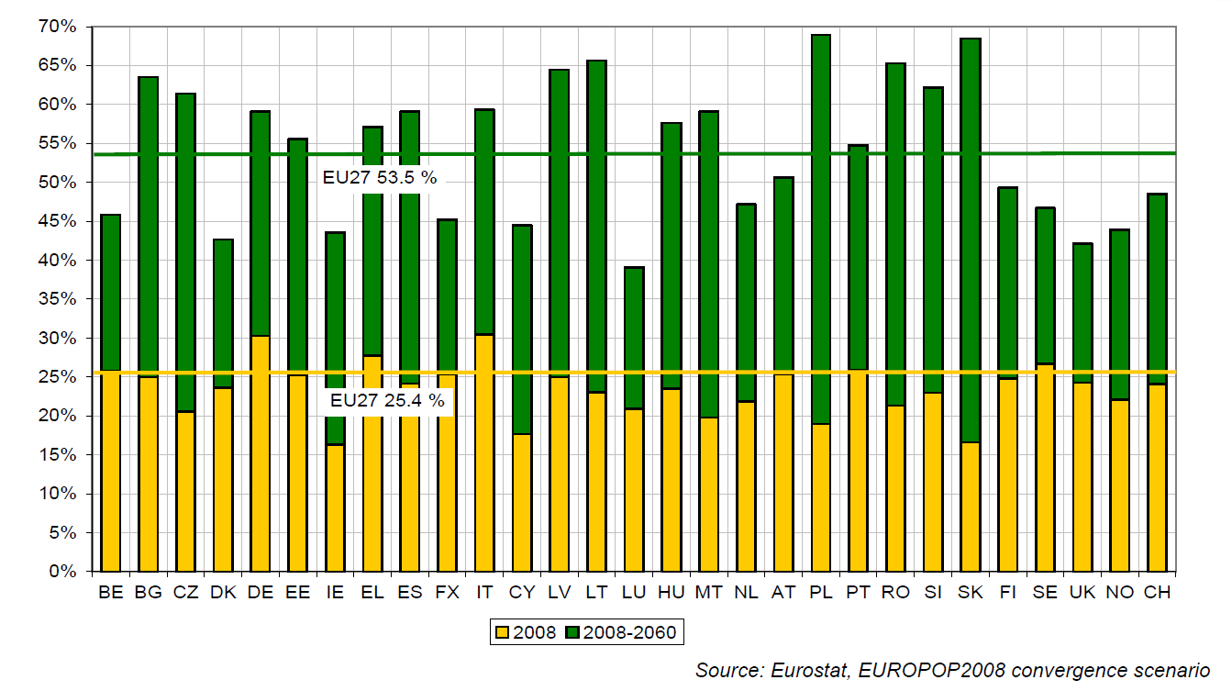
Dependency Ratio

Slide 6
Aging population
Two scenarios:
Malthusian something (correction, crisis, disaster)
Slow adjustment to a new equilibrium
Right now – neither here, nor there
Rigid pension systems
Modigliani’s life-cycle hypothesis

Slide 7
Retirement
Older population => retirement costs
Retirement age
Labor force
People / Job opening
Youth unemployment

Slide 8
Labor Force
Labor force => Need for capital
(later on this)
Rigid or flexible labor force?
If the former – youth unemployment
If the latter - youth unemployment

Slide 9
Changes…
Aging population => consumption , savings , investment
Theoretically – lower capital formation (young people and their toys)
But theoretically – greater role of the services sector (labor intensive)

Slide 10
What’s it to young people?
They are:
Flexible, energetic, familiar with the world
Less demanding, short-sighted, easily manipulated
Lacking experience, which is not always a bad thing
Worst hit during layoffs

Slide 11
Causes for youth unemployment
Definition: unemployed / labor force(15-24)
Possible causes:
Education; skills and expectations mismatch; shocks; grey economy; geographical; migration.

Slide 12
We’re doing this ourselves…
75% employment - job creation?
Green economy – higher costs!
40% tertiary education - !?

Slide 13
Thank you for your attention
Last Slide!

